Slide 1
DISTRIBUTED SYSTEMS
Introduction to Distributed Systems

Slide 2
Learning Outcomes
By the end of this chapter, the learner should be able to:
Describe the design issues of distributed system.
Discuss advantages and limitations of Distributed Computing Systems.
Describe organization of Distributed Computing Systems.
Describe the concept of Distributed Systems,

Slide 3
Introduction
Networks of computers are everywhere.
The Internet is one, as are the many networks of which it is composed.

Slide 4
Introduction
Mobile phone networks, corporate networks, factory networks, campus networks, home networks, in-car networks –all of these, both separately and in combination, share the essential characteristics that make them relevant subjects for study under the heading distributed systems.

Slide 5
Centralized Systems
Early computing was performed | on | a | single
processor. Uni-processor computing can | be |  | called
centralized computing.
Centralized systems have non-autonomous components

Slide 6
Centralized Systems
Centralized systems are often built homogeneous technology.
Multiple users share the resources of a
using
centralized system at all times.
Centralized systems have a single point of control and of failure.

Slide 7
Centralized Systems
terminal
mainframe computer
workstation
network link
network host
distributed computing
centralized computing

Slide 8
Distributed Systems
A distributed system consists of a number of components, which are themselves computer systems.
These components are connected by some communication medium, usually a sophisticated network.

Slide 9
Distributed Systems
Applications execute by using a number of processes in different component systems.
These processes communicate and interact to achieve productive work within the application.

Slide 10
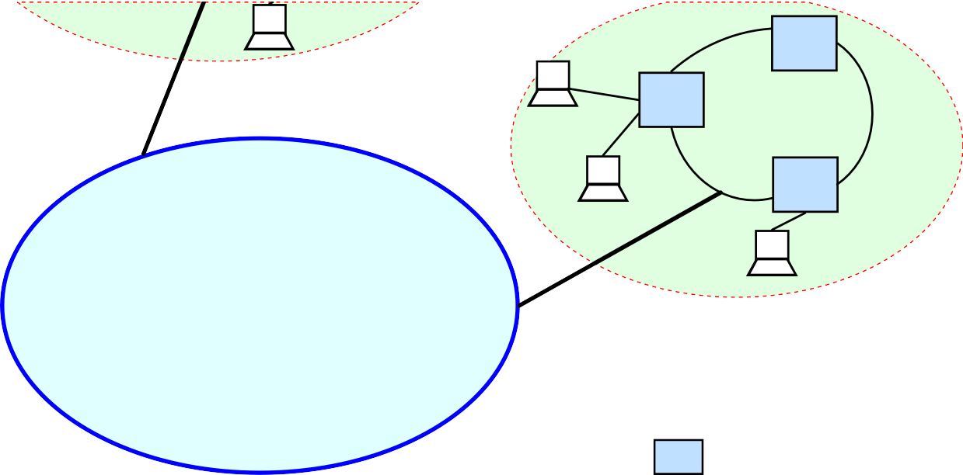
Distributed Systems
work stations
a local network
The Internet
a network host

Slide 11
Distributed System
A distributed system consists of a collection of autonomous computers, connected through a network and distribution middleware, which enables computers to coordinate their activities and to share the resources of the system, so that users perceive the system as a single, integrated computing facility.

Slide 12
Distributed Systems
This simple definition covers the entire range of systems in which networked computers can usefully be deployed.
Computers that are connected by a network may be spatially separated by any distance.

Slide 13
Distributed Systems
These computer networks may be on separate continents, in the same building or in the same room.
Distributed computing is a method processing in which different parts
of computer of a program
are run simultaneously on two or more computers that are communicating with each other over a network.

Slide 14
Distributed Computing
Distributed computing is a type of segmented or parallel computing, but parallel computing is most commonly used to refer to processing in which different parts of a program run simultaneously on two or more processors that are part of the same computer.

Slide 15
Distributed Computing
While both types of processing require that a program be segmented—divided into sections
that can computing
run simultaneously, distributed also requires that the division of
the program take into account the different environments on which the different sections of the program will be running.

Slide 16
Distributed Computing
For example, two have different file
computers systems
are likely to and different
hardware components.
Distributed computing is a natural
result of
using networks to enable communicate efficiently.
computers to

Slide 17
Distributed Computing
Computer computing computers
or fragmented two or more
networking
refers to
interacting with each other, but
not, typically, sharing the processing of a single program.

Slide 18
Distributed Computing
The World Wide Web is an example of a
network, but not an example of computing.
distributed

Slide 19
Examples of Distributed Systems
Automatic Teller Machine network.
Internet.
Mobile and Ubiquitous Computing.

Slide 20
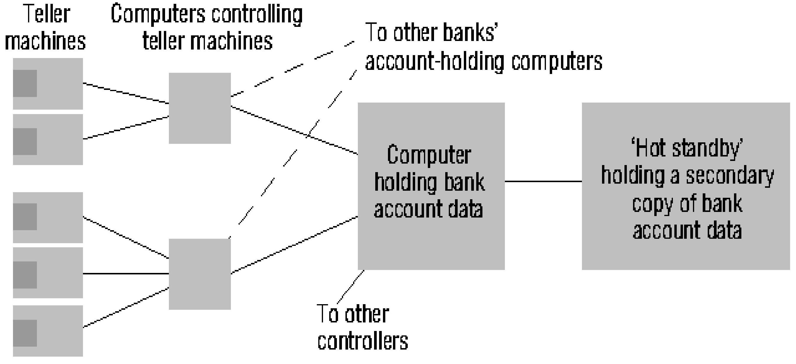
Automatic Teller Machine Network

Slide 21


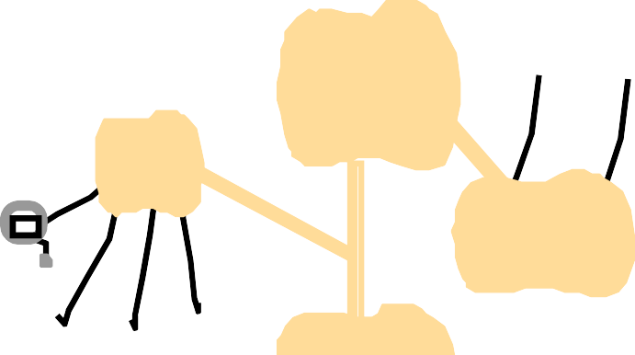










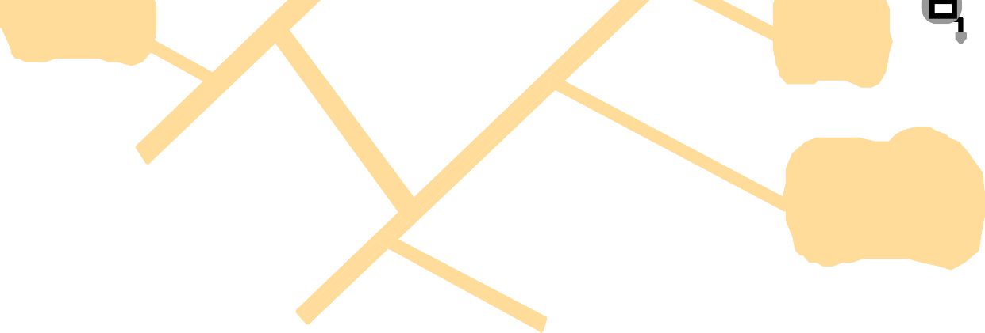











Internet
intranet

ISP



backbone
satellite link
desktop computer:
server: network link:

Slide 22
Mobile and Ubiquitous Computing
Internet
Host intranet
GSM/GPRS
gateway
Home intranet
Wireless LAN
Mobile phone
Laptop
Printer
Camera
Host site

Slide 23
Why are Systems Distributed?
Distributed systems have been around since the early 1970’s and have been made possible by advances in computer and communications technology.

Slide 24
Why are Systems Distributed?
Systems are distributed for either or both of two main reasons:
Organizations today are expanding far beyond their traditional geographic boundaries in search for new business, new customers, new markets and improved financial and organizational viability. Consequently, an organization and its information systems may be inherently distributed and in connecting its systems into a seamless whole, a distributed system appears.
An organization may take inherently centralized information processing systems and distribute them to achieve higher reliability, availability, safety or performance, or all of the above.

Slide 25
Characteristics of Distributed Systems
Multiple autonomous processing elements
Information exchange over a network
Processes interact via non-shared local memory
Transparency.

Slide 26
Multiple autonomous processing elements
A distributed system is composed of several independent components each with processing ability.
There is no master-slave relationship between processing elements.

Slide 27
Information exchange over a network
Thus, it excludes traditional centralized mainframe based systems.
The network connects autonomous processing elements.

Slide 28
Processes interact via non-shared local memory.
Multiple processor computer systems can be
classified into those that share memory (multiprocessor those
computers) and
without shared memory (multi-computers).
A hybrid configuration involves separate computers with a distributed shared memory.

Slide 29
Transparency
A distributed system is designed to conceal from the users the fact that they are operating over a wide spread geographical area and provide the illusion of a single desktop environment.

Slide 30
Transparency
It should allow every part of the system to be viewed the same way regardless of the system size and provide services the same way to every part of the system.

Slide 31
Transparency
Some aspects of transparency include:
Global names.
Global access.
Global security.
Global management.

Slide 32
Global names
The same name works everywhere.
Machines, users, files, control groups and services have full names that mean the same thing regardless of where in the system the name is used.

Slide 33
Global access
The same functions are usable everywhere with reasonable performance.
A program can run anywhere and get the same results.
All the services and objects required by a program to run are available to the program regardless of where in the system it is executing.

Slide 34
Global security
Same user authentication and control access work everywhere e.g. same mechanism to let the same person next door and someone at another site read ones files.
Authentication to any computer in the system.

Slide 35
Global management
The same person can administrate system components anywhere.
System management tools perform the same actions e.g. configuration of workstations.

Slide 36
Components of a Distributed System.
A distributed components:
Data.
Processing.
Presentation.
System has three major

Slide 37
Data
This is concerned with the structures and functions for information retention and manipulation.

Slide 38
Processing
This is objects.
concerned with processing data

Slide 39
Presentation
Presentation is processing directly concerned with making data visible to users and handling user interaction.

Slide 40
Advantages of Distributed Systems.
Fault tolerance.
Flexibility.
Extensibility.
Upgrade.
Local autonomy.
Reliability and Availability.
Localized security breaches.
Improved performance.

Slide 41
Fault-tolerant
It can be designed so that if one component of the system fails then the others will continue to work.
Such a system will provide useful work in the face of quite a large number of failures in individual component systems.

Slide 42
More flexible
A distributed system can be made up from a number of different components.
Some of these components may be specialized for a specific task while others may be general purpose.
Components can be added, upgraded, moved and removed without impacting upon other components.

Slide 43
Easier to extend
More processing, storage or other power can be obtained by increasing the number of components.

Slide 44
Easier to upgrade
When a single large computer system becomes obsolete all of it has to be replaced in a costly and disruptive operation.
A distributed system may be upgraded in increments by replacing individual components without a major disruption, or a large cash injection.

Slide 45
Local autonomy
By allowing domains of control to be defined where decisions are made relating to purchasing, ownership, operating priorities, IS development and management, etc.
Each domain decides where resources under its control are located.

Slide 46
Increased Reliability and Availability
In a centralized system, a component failure can mean that the whole system is down, stopping all users from getting services.
In a distributed system, multiple components of the same type can be configured to fail independently.

Slide 47
Increased Reliability and Availability
This aspect of replication of components improves the fault tolerance in distributed systems, consequently, the reliability and availability of the system is enhanced.

Slide 48
Improved Performance
Large centralized systems can be slow performers due to the sheer volume of data and transactions being handled.
A service that is partitioned over many server computers each supporting a smaller set of and users access to local data and resources results in faster access.

Slide 49
Improved performance
Another performance advantage is the support for parallel access to distributed data across the organization.

Slide 50
Security breaches are localized
In distributed systems with multiple security control domains, a security breach in one domain does not compromise the whole system.
Each security domain has varying degree of security authentication, access control and auditing.

Slide 51
Disadvantages of Distributed Systems
It’s more difficult to manage and secure.
Lack of skilled support and development Staff.
They are significantly more complex.
They introduce problems of synchronization between processes.
They introduce problems of maintaining consistency of data.

Slide 52
It’s more difficult to manage and secure.
Centralized systems are inherently easier to secure and easier to manage because control is done from a single point. Distributed systems require more complex procedures for security, administration, maintenance and user support due to greater levels of co-ordination and control required.

Slide 53
Lack of skilled support and development Staff.
Since the equipment and software in a DS can be sourced from different vendors, unlike in traditional systems where everything is sourced from the same vendor, its difficult to find personnel with a wide range of skills to offer comprehensive support.

Slide 54
Distribution Transparency
A transparency is some aspect of the distributed system that is concealed from the user, programmer or system developer.

Slide 55
Distribution Transparency
A major consideration when designing distributed systems is the extent to which the distribution of components of the system should be made transparent to the application designers and users because there are trade- offs to be made.

Slide 56
Distribution Transparency
Users demand a simple user interface to this complex world, which in turn, demands functions for concealing complexity. Most users desire a single system image where all resources are perceived to be centralized at the desktop computer.

Slide 57
Distribution Transparency
The term distribution transparency is used to describe the visibility of distributed components within a distributed system.
There are two major transparency choices:
Partial or selective Distribution Transparency
Full Distribution Transparency

Slide 58
Full Distribution Transparency
Complexities introduced by distribution are completely concealed.
It simplifies application development and improves usability.
In addition, it accommodates the incorporation of existing systems based on centralized systems.

Slide 59
Full Distribution Transparency
For example, a database application designed to execute on a single host machine is able to make use of distributed resources without knowledge of whether the resource is local or remote and with no change to the application.

Slide 60
Partial or selective Distribution Transparency.
The application designer may need to reveal that some DS components are distributed and therefore requires a development environment that gives some freedom to take account of this.

Slide 61
Partial or selective Distribution Transparency
Full distribution does not allow applications the opportunity to exploit decentralization at the level of application process.

Slide 62
Partial or selective Distribution Transparency
It’s the designer who chooses the extent to which users are made aware of distributed components by selecting a level of distribution transparency appropriate to the application.

Slide 63
Types of Transparency
Access transparency
Location Transparency .
Concurrency Transparency .
Replication Transparency .
Fault Transparency .
Migration Transparency.
Performance Transparency.
Scaling Transparency.

Slide 64
Access transparency
Hiding the use of communications to access remote resources like program files, data, printers, etc. so that the user is under the illusion that all resources are local.

Slide 65
Access transparency
Remote resources are accessed using exactly the same mechanism for accessing local resources.
From a programmer’s point of view, the access method to a remote object may be identical to access a local object of the same class.

Slide 66
Access transparency
This transparency has two parts:
Keeping a syntactical or mechanical consistency between distributed and non-distributed access
Keeping the same semantics. Because the semantics of remote access are more complex, particularly failure modes, this means the local access should be a subset.

Slide 67
Location Transparency
The details of the topology of the system should be of no concern to the user.
The location of an object in the system may not be visible to the user or programmer.

Slide 68
Location Transparency
This differs from access transparency in that both the naming and access methods may be the same.
Names may give no hint as to location.

Slide 69
Concurrency Transparency
Users and Applications should be able to access shared data or objects without interference between each other.
This requires very complex mechanisms in a
distributed concurrency
system,
rather
since
than
there exists true the simulated
concurrency of a central system.

Slide 70
Concurrency Transparency
For example, a distributed printing service must provide the same atomic access per file as a central system so that printout is not randomly interleaved.

Slide 71
Replication Transparency
Hiding differences between replicated and non-replicated resources.
If the system provides replication (for availability or performance reasons) it should not concern the user.

Slide 72
Fault Transparency
If software or hardware failures occur, these should be hidden from the user.
This can be difficult to provide in a distributed system, since partial failure of the communications subsystem is possible, and this may not be reported.

Slide 73
Fault Transparency
As far as possible, fault transparency will be provided by mechanisms that relate to access transparency.
However, when the faults are inherent in the distributed nature of the system, then access transparency may not be maintained.

Slide 74
Fault Transparency
The mechanisms that allow a system to hide faults may result in changes to access mechanisms (e.g. access to reliable objects may be different from access to simple objects).

Slide 75
Fault Transparency
In a software system, especially a networked one, it is often hard to tell the difference between a failed and a slow running process or processor.
This distinction is hidden or made visible here.

Slide 76
Migration Transparency
If objects (processes or data) migrate (to provide better performance, or reliability, or to hide differences between hosts), this should be hidden from the user.
This means that resources can be relocated dynamically without the user being aware of reconfigurations.

Slide 77
Performance Transparency
Minimizing performance overheads in using remote resources, so that the response time and through put are comparable with cases when all resources are local.
The configuration of the system should not be apparent to the user in terms of performance.

Slide 78
Performance Transparency
This may require complex resource management mechanisms.
It may not be possible at all in cases where resources are only accessible via low performance networks.

Slide 79
Scaling Transparency
A system should be able to grow without
affecting application algorithms. growth and evolution is an
Graceful important
requirement for most enterprises.

Slide 80
Scaling Transparency
A system should also be capable of scaling down to small environments where required, and be space and/or time efficient as required.

Slide 81
Transparency
If all of the above transparency functions are built into the IT infrastructure (usually the software components) then full distribution transparency can be achieved.

Slide 82
Transparency
The degree of distribution transparency is a measure of the distributed nature of the IT infrastructure.

Slide 83
Issues in Design of Distributed systems
There are key designs issues that people building distributed systems must deal with, with a goal to ensure that they are attained.

Slide 84
Issues in Design of Distributed systems
These design issues are:
Transparency
Fault tolerance
Openness
Concurrency
Scalability
Performance

Slide 85
Transparency
This is one of the key design issues in distributed systems.
To design a system that achieves a single system image is very challenging.
The concept of transparency has been proposed to describe distributed systems that can be made to behave like their non-distributed counterparts.

Slide 86
Transparency
It is described as “the concealment from the user and the application programmer of the separation of components in a distributed system so that the system is perceived as a whole rather than a collection of independent components.”

Slide 87
Transparency
Transparency there involves hiding all the distribution from human users and application programs

Slide 88
Fault Tolerance
Since failures are inevitable, a computer system can be made more reliable by making it fault tolerant.
A fault tolerant system is one designed to fulfill its specified purposes despite the occurrence of component failures (machine and network).

Slide 89
Fault Tolerance
Fault tolerant systems are designed to mask component failures i.e. attempt to prevent the failure of a system in spite of the failure of some of its components.

Slide 90
Fault Tolerance
Fault tolerance can be achieved through hardware and software.
Software – Replication of programs e.g. replication of applications
Backward error recovery e.g. rollbacks and save points in database systems
Hardware – redundant hardware components e.g. multiple processors

Slide 91
Fault Tolerance
Redundancy is defined as those parts of the system that are not needed for the correct functioning of the system if no fault tolerance is supported.
Meaning that the system will continue to work correctly without redundancy if no failure occurs.

Slide 92
Fault Tolerance
Redundancy can be exhibited in both hardware and software components.
Fault tolerance improves system availability and reliability.
Fault tolerance masks faults, which means that it makes faults not visible to the users externally.

Slide 93
Fault Tolerance
The system still continues to function according to the specification.
Fault tolerance can also be achieved by fault prevention i.e. trying to detect any fault in hardware and software before connecting to the system. For example program debugging.

Slide 94
Fault Tolerance
Although fault
tolerance improves the system
availability and reliability, it brings some overheads in terms of:
Cost - increased system costs
Software development – recovery mechanisms and testing
Performance – makes system slower in updates of replicas
Consistency – maintaining data consistency is not trivial

Slide 95
Concurrency
Concurrency arises in a system when several processes run in parallel.
If these processes are not controlled then inconsistencies may arise in the system.

Slide 96
Concurrency
This is an issue in of distributed systems because designers have to do this carefully and keenly to control the problem of inconsistency and conflicts.

Slide 97
Concurrency
The end result is to achieve a serial access illusion.
Concurrency control is important to achieve proper resource sharing and co-operation of processes.

Slide 98
Openness
This is the ability of the system to accommodate different technology (hardware and software components) without changing the underlying structure of the system.

Slide 99
Openness
For example, the ability to accommodate a 64- bit processor where a 32-bit processor was being used without changing the underlying system structure or the ability to accommodate a machine running a MAC O/S in a predominantly Windows O/S system.

Slide 100
Openness
A distributed system should be open with respect to software vendors, developers, hardware components etc. this calls for well-defined interface so that the user just issues commands or requests without regard to the way the function is implemented so that you can have multiple independently developed copies using the same interface to provide services to the users.

Slide 101
Scalability
Each component of a distributed system has a finite capacity.
Designing for scalability involves calculating the capacity of each of these elements and the extent to which the capacity can be increased.

Slide 102
Performance
There are two common measures of performance for distributed systems:
Response time – defined as the average elapsed time from the moment the user is ready to transmit and the entire response is received. The response received depends on the nature of the user interaction.
Throughput – the number of requests handled per unit time.

Slide 103
Performance
Satisfactory performance as perceived by the users is dependent on the nature of the task being performed.
The components in the path between and application
all have | performance characteristics that | will
determine | performance characteristics that | will
determine | overall performance as perceived by | the
user.

Slide 104
Performance
Servers will queue user requests until the necessary resource becomes available.
In order to calculate performance in terms of response time the utilization of each component needs to be established and the effects of queuing calculated.

Slide 105
Performance
An alternate approach to improving CPU performance is to implement multi-processor or multi-computer configurations where each CPU handles a portion of the total workload.

Slide 106
Performance
Effectively, the total workload is handled by a service that is partitioned across multiple CPU server group.
When workload is partitioned across multiple servers, resolution protocol is required to find the server that is able to satisfy the client request.

Slide 107
Performance
Performance improvements can be made in
by migrating
much of the processing on to a user’s client workstation.
This reduces the processing on the server per client request, which, leads to faster, and more predictable response time
distributed systems environment

Slide 108
END

